Slide 1

Input Devices

Slide 2
Input Devices
Input devices are components of a system or device that allow users to input data or commands into an electronic system. In the context of electric circuits, input devices play a crucial role in providing signals or information to the circuit, which can then be processed or utilized in various ways
Switches: These devices open or close circuits, controlling the flow of electric current. They range from simple push-buttons to complex electronic switches like transistors.
Sensors: Detect and measure physical properties like temperature, light, or motion, converting them into electrical signals. Examples include temperature sensors, light sensors, accelerometers, and proximity sensors.
Potentiometers: Variable resistors allowing manual adjustment of resistance in a circuit. They control parameters like volume, brightness, or motor speed.
Keyboards/Keypads: Input alphanumeric characters or commands via buttons or keys, each representing a specific function, sending electrical signals when pressed.
Microphones: Convert sound waves into electrical signals for applications like voice recognition, audio recording, or speech synthesis.
Cameras: Capture visual information, converting it into electrical signals for tasks such as image analysis, object detection, or surveillance.

Slide 3
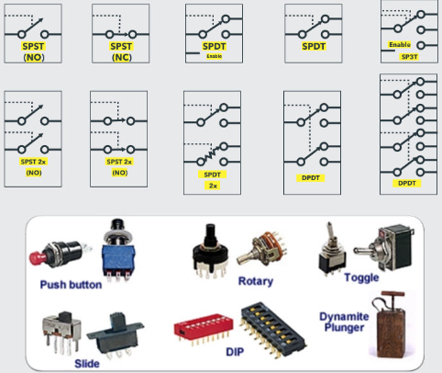
Switches
Switches are devices that control the flow of electric current in a circuit. They can either allow or block the flow of electricity depending on their state. When a switch is in the "on" position, it completes the circuit, allowing current to flow through it. In contrast, when the switch is in the "off" position, it interrupts the circuit, preventing the flow of current.
Switches operate based on various mechanisms:
Toggle Switch: Flips between on/off positions mechanically.
Pushbutton Switch: Completes the circuit temporarily when pressed.
Rotary Switch: Selects different positions via mechanical rotation.
Slide Switch: Moves between different positions via sliding.
Rocker Switch: Operates like a seesaw to toggle between on/off states.
Reed Switch: Relies on the proximity of magnets to complete the circuit.

Slide 4
Switches & It’s Functionality
Switch Type | Functionality
Toggle Switch | Basic on/off control
Pushbutton Switch | Momentary activation
Rotary Switch | Selection of different positions
Slide Switch | Multiple position selection
Rocker Switch | Quick, seesaw motion for operation
Reed Switch | Activation by magnetic field proximity
Mercury Tilt Switch | Circuit completion upon tilting

Slide 5
Switches & Its Phenomena
Switch Type | Phenomena | Advantages
Toggle Switch | Mechanical movement to open/close circuit | Simple design, easy to operate
Pushbutton Switch | Mechanical pressure to complete circuit | Momentary activation, suitable for temporary functions
Rotary Switch | Mechanical rotation to select positions | Selection of multiple functions/settings
Slide Switch | Mechanical sliding to select positions | Compact design, easy to integrate into small devices
Rocker Switch | Mechanical seesaw motion to operate | Quick and easy operation, suitable for frequent use
Reed Switch | Magnetic field proximity to complete circuit | Activation without physical contact, reliable operation

Slide 6
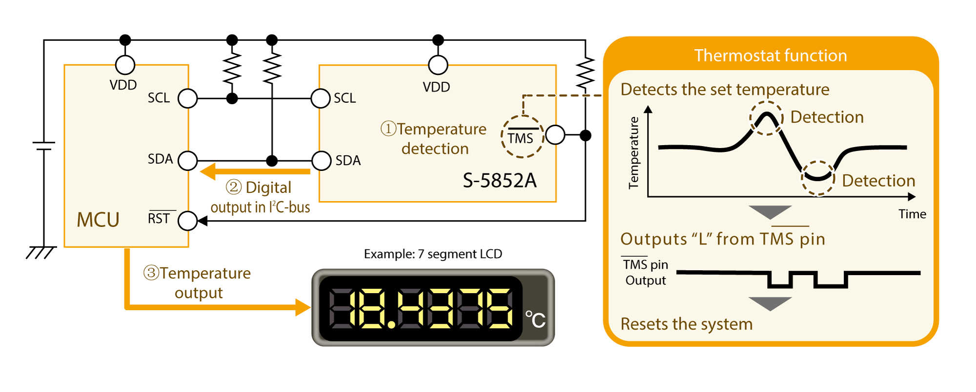
Temperature Sensors
Temperature Sensors:
Temperature sensors are devices designed to detect changes in temperature and convert them into electrical signals. These signals are then utilized for various purposes in a wide range of applications. Here's a detailed explanation:
Functionality:
Temperature sensors operate based on the principle of detecting changes in temperature and converting them into electrical signals. They typically utilize temperature-dependent physical properties of materials, such as resistance, voltage, or frequency, to measure temperature variations accurately.

Slide 7
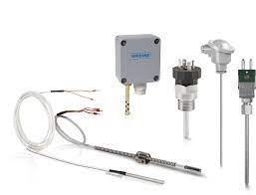
Applications Of Temperature Sensor
Temperature sensors find extensive use in various fields, including:
Thermostats: Controlling heating and cooling systems in homes, offices, and industrial settings to maintain desired temperature levels.
Appliances: Monitoring and regulating temperatures in refrigerators, ovens, and air conditioners for optimal performance.
Medical Devices: Monitoring body temperature in thermometers, incubators, and medical diagnostic equipment.
Industrial Process Control: Ensuring precise temperature control in manufacturing processes for quality assurance and efficiency.

Slide 8
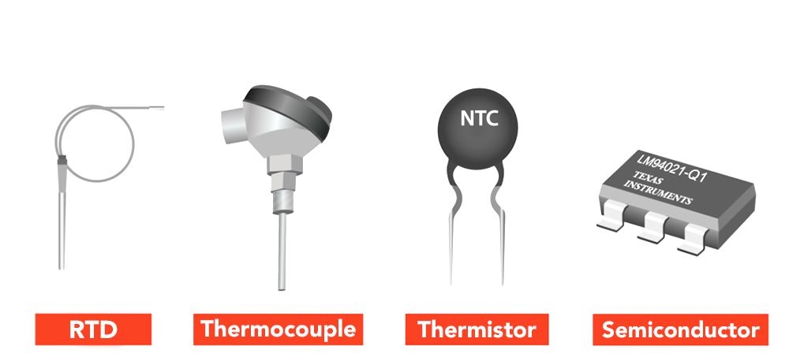
Types Of Temperature Sensor
Thermocouples: These sensors utilize the Seebeck effect, where two dissimilar metals generate a voltage proportional to the temperature difference between the hot and cold junctions.
RTDs (Resistance Temperature Detectors): RTDs measure temperature by changes in electrical resistance of conductive materials with temperature. Platinum is commonly used for its stability and linear resistance-temperature relationship.
Thermistor Temperature Sensors: Thermistors are passive devices with resistance varying with temperature. Negative Temperature Coefficient (NTC) thermistors decrease resistance with temperature, while Positive Temperature Coefficient (PTC) thermistors increase resistance.
Semiconductor Temperature Sensors: Also known as solid-state sensors, these devices use semiconductor diodes or transistors with voltage-current characteristics dependent on temperature.

Slide 9
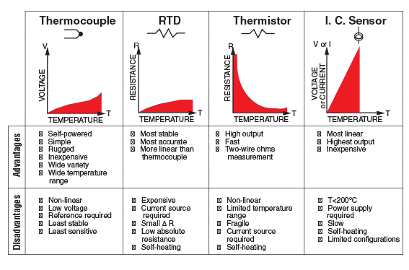
Temperature Sensor

Slide 10
Applications
HVAC Systems: Temperature sensors are vital components in heating, ventilation, and air conditioning systems, ensuring comfortable indoor environments while optimizing energy efficiency.
Industrial Processes: Temperature sensors play a critical role in industrial processes, facilitating precise temperature control in manufacturing, chemical processing, and refining industries to maintain product quality and safety.
Medical Devices: Temperature sensors are essential in medical devices such as thermometers and patient monitoring systems, accurately measuring body temperature for diagnostic and therapeutic purposes in healthcare settings.
Automotive: Temperature sensors are integral to automotive systems, monitoring engine temperature, coolant temperature, and cabin temperature to ensure optimal performance, prevent overheating, and enhance passenger comfort.
Food and Beverage Industry: Temperature sensors are crucial in the food and beverage industry, monitoring and controlling temperatures during food processing, storage, and transportation to ensure food safety and quality standards are met.

Slide 11
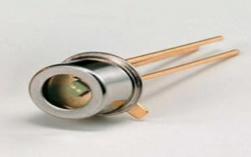
Photo Detecter
The photodetector is an essential component in an optical receiver that converts the incoming optical signal into an electrical signal. Semiconductor photodetectors are usually called photodiodes because these are the main types of photodetectors utilized in optical communication systems due to their quick detection speed, high detection efficiency & small size. At present, photodetectors are widely used in industrial electronics, electronic communications, medicine & healthcare, analytical equipment, automotive & transport, and many more. These are also known as photosensors and sensors of light. So, this article discusses an overview of a photodetector – working with applications
What is Photodetector?
A photodetector definition is; an optoelectronic device that is used to detect the incident light or optical power to convert it into an electrical signal is known as a photodetector. Usually, this o/p signal is proportional to the incident optical power. These sensors are absolutely needed for different scientific implementations like process control, fiber optic communication systems, safety, environmental sensing & also in defense applications. Examples of photodetectors are phototransistors and photodiodes.

Slide 12
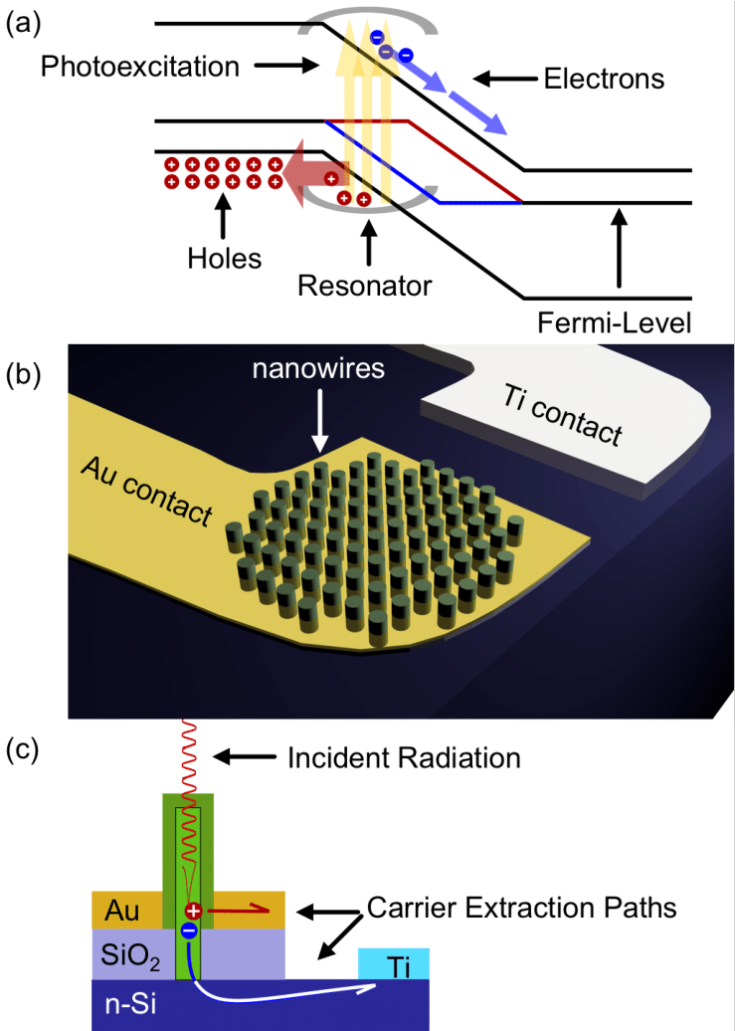
How Photodetector Works?
Photodetector simply works by detecting light or other electromagnetic radiation or devices may by receiving the transmitted optical signals. Photodetectors that use semiconductors operate on the electron-hole pair creation upon the light irradiation principle.
Once a semiconductor material is illuminated through photons that have high or equivalent energies to its bandgap, then absorbed photons encourage valence band electrons to move into the conduction band, so leaving behind holes within the valence band. The electrons in the conduction band perform as free electrons (holes) that can disperse under the power of an intrinsic or externally applied electric field.
The photo-generated electron-hole pairs because of optical absorption may recombine & re-emit light unless subjected to an electric field-mediated separation to give an increase to a photocurrent, which is a fraction of the photo-generated free charge carriers received at the electrodes of the photodetector arrangement. The photocurrent magnitude at a specified wavelength is directly proportional to the intensity of incident light.

Slide 13
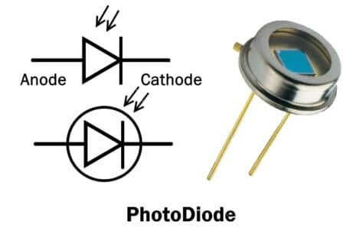
Photodetector Types
The photodetectors are classified based on the detection mechanism of light like the photoelectric or photoemission effect, polarization effect, thermal effect, weak interaction, or photochemical effect. The different types of photodetectors mainly include a photodiode, MSM photodetector, phototransistor, photoconductive detector, phototubes & Photomultipliers.
Photodiodes
These are semiconductor devices with a PIN or PN junction structure where light is absorbed within a depletion region & produces a photocurrent. These devices are fast, highly linear, very compact and generate a high quantum efficiency which means it generates almost one electron for each incident photon & a high dynamic range. Please refer to this link to know more about Photodiodes.

Slide 14
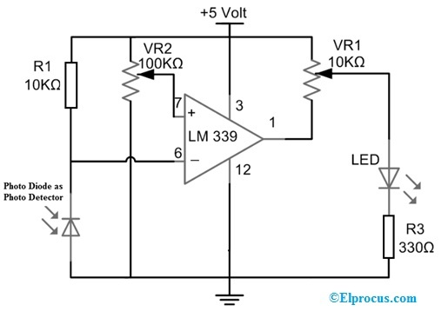
Photodetector Circuit Diagram
The light sensor circuit using a photodetector is shown below. In this circuit, the photodiode is used as a photodetector to detect the existence or nonexistence of light. This sensor’s sensitivity can be simply adjusted by using the preset.
The required components of this light sensor circuit mainly include a photodiode, LED, LM339 IC, Resistor, Preset, etc. Connect the circuit as per the circuit diagram shown.

Slide 15
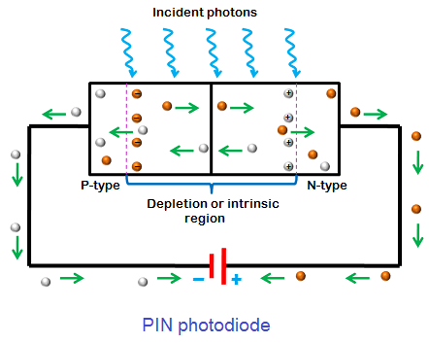
Working
A photodiode is used as a photodetector to generate current within the circuit once light falls on it. In this circuit, the photodiode is used in reverse bias mode through the R1 resistor. So this R1 resistor does not permit too much current to supply throughout the photodiode in case a huge amount of light drops on the photodiode.
When no light falls on the photodiode, then it results in high potential at the pin6 of an LM339 comparator (inverting input). Once light falls on this diode, then it allows current to supply throughout the diode & thus voltage will drop across it. The pin7 (non-inverting input) of the comparator is connected to a VR2 (variable resistor) to set the comparator’s reference voltage.
Here, a comparator works when the non-inverting input of the comparator is high as compared to inverting input then its output remains high. So the output pin of IC like pin-1 is connected to a light emitting diode. Here, the reference voltage is set throughout a VR1 preset to correspond to a threshold illumination. At the output, the LED will be turned ON once light falls on the photodiode. So, the inverting input drops to a lower value as compared to the reference set at the non-inverting input. So, the output goes supplying the required forwards bias to the light-emitting diode.

Slide 16
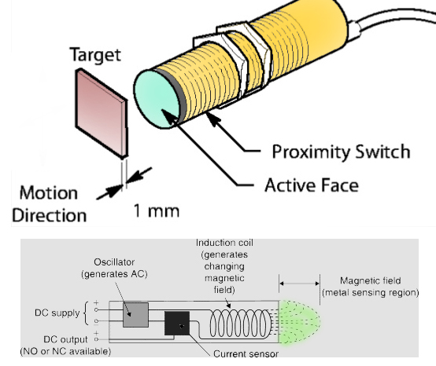
Proximity Sensors
A proximity sensor is a sensor used to detect the presence of nearby objects in a non-contact nature. These sensors then convert the information about presence or movement of an object into an electrical signal
Technical Definition and Meaning of Proximity Sensors
The essence of Proximity sensors is detecting the movement/presence of objects without physical contact and converting that data into an electrical signal. Therefore, all sensors that perform non-contact detection are included in the category of proximity sensors. Proximity sensors are also commonly referred to as “proximity switches” (by the Japanese Industrial Standards), and include all the sensors that non-contact detect objects within the general vicinity of the sensor.

Slide 17
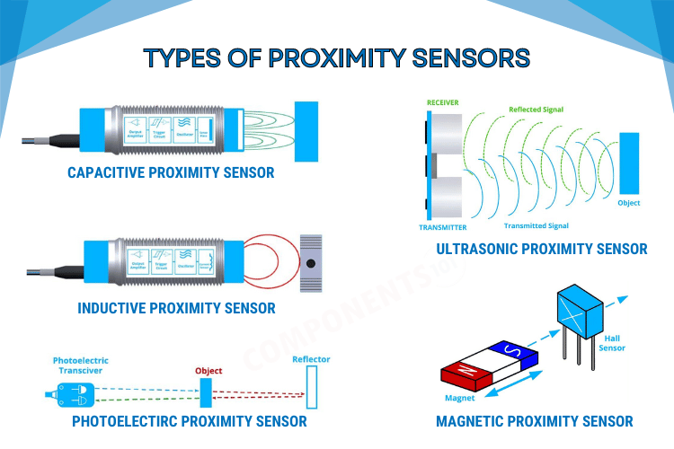
Main Types Of Proximity Sensors
Proximity sensors come in two main types: inductive and capacitive. Inductive sensors use electromagnetic induction to detect metallic objects, while capacitive sensors detect changes in electrical capacitance caused by objects approaching the sensor. Both types have distinct advantages and are widely used in various industries.
Additionally, there are other common types of proximity sensors. Magnetic sensors detect ferrous objects using magnetic fields, while reed switch sensors activate when exposed to a magnetic field. Ultrasonic sensors emit sound waves to detect objects, and photoelectric sensors use light beams for detection.
Each type of proximity sensor has specific applications based on factors like object material and environmental conditions. Choosing the right sensor type is essential for accurate and reliable object detection in industrial and commercial settings.

Slide 18
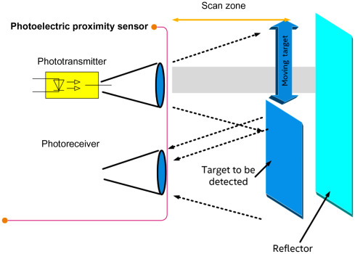
General Advantages And Features Of Proximity Sensors
Contactless Sensing:
Proximity sensors eliminate the need for physical contact, simplifying design and increasing service life.
Resistance in Physical Environments:
Resilient to oily, dusty, or wet surroundings and can operate in temperatures from -40 to 200 °C.
Unaffected by Surface Conditions:
Detection is not affected by surface colors or visual conditions of objects.
Response Speed:
Offers faster detection compared to contact-requiring switches.

Slide 19
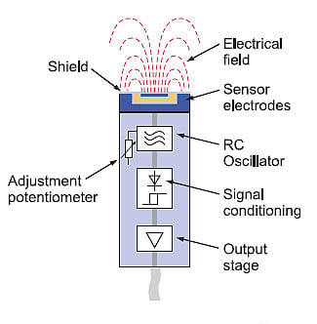
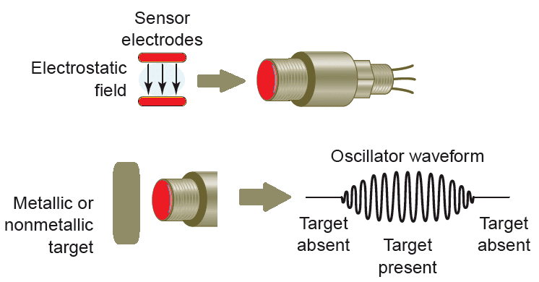
Proximity Sensor Types And Characteristics
Inductive Proximity Sensors:
Detect metallic objects using electromagnetic induction.
Widely used in security and automation applications.
Limitations include narrow detection range and susceptibility to external factors.
Capacitive Proximity Sensors:
Detect both metallic and non-metallic objects.
Widely used in automation and fluid level detection.
Limited detection range and higher cost compared to inductive sensors.

Slide 20
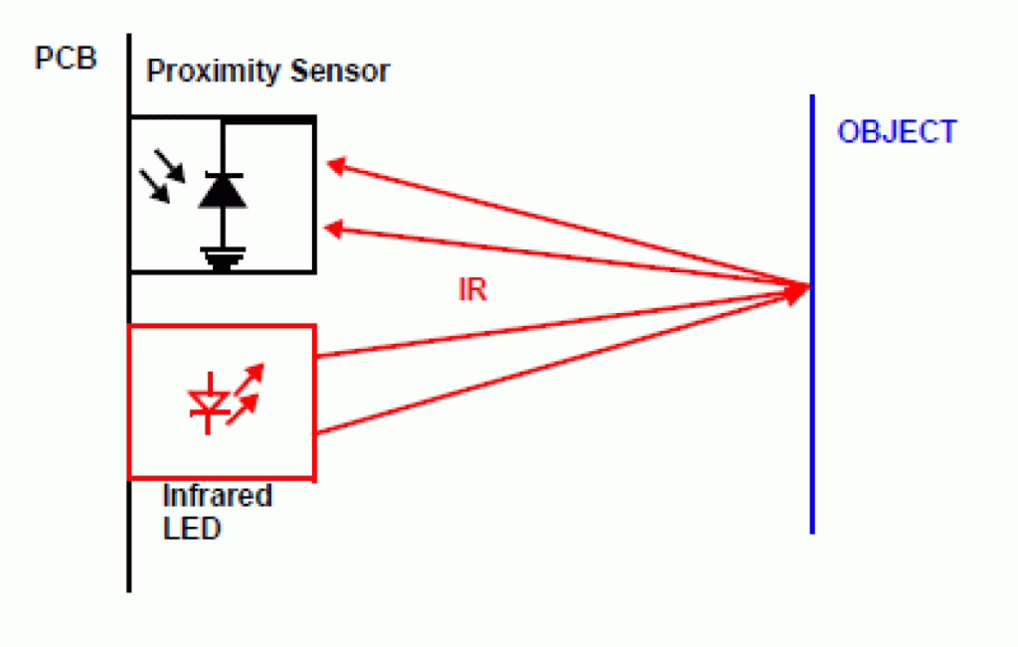
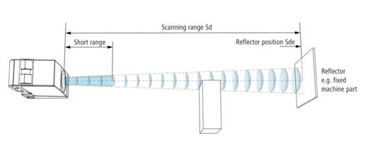
Proximity Sensor Types And Characteristics
IR Proximity Sensors:
Emit infrared light to detect object presence.
Suitable for distance measurement and security systems.
Affected by environmental conditions and require clear visibility for detection.
Ultrasonic Proximity Sensors:
Emit high-frequency ultrasonic waves to detect objects.
Used in distance measurement and automation processes.
Limited detection range and sensitivity to object textures.

Slide 21
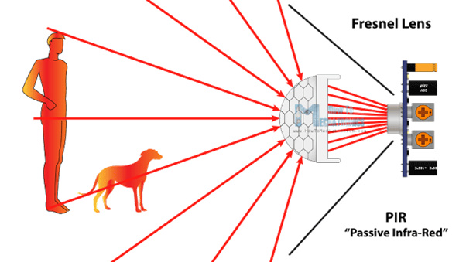
Motion Sensor
Motion sensors play a crucial role in various IoT applications, particularly in smart homes and industries. They are instrumental in enhancing security, saving energy, and gathering valuable data. This article explores the workings of motion sensors, focusing on three common types: Passive Infrared (PIR), Microwave, and Dual Tech/Hybrid.
Motion Sensors Explanation
Motion sensors are widely used for security and energy efficiency purposes. They detect motion in their vicinity and trigger actions accordingly. For instance, they can activate security cameras or turn off lights when no motion is detected. The three primary types of motion sensors are Passive Infrared (PIR), Microwave, and Dual Tech/Hybrid.

Slide 22
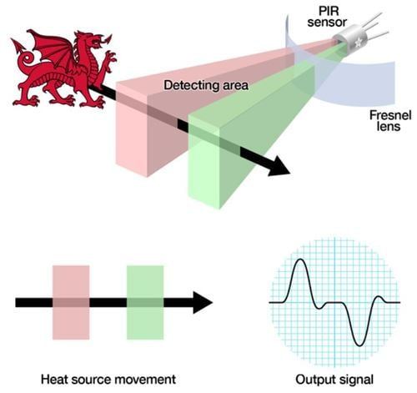
Passive Infrared Sensors (PIR)
PIR sensors detect motion by sensing changes in temperature between the background and a warm body.
Working Principle:
They contain a pyro electric sensor that detects levels of infrared radiation emitted by objects. When a warm body enters the sensor's field of view, it causes a differential change between two slots, triggering a pulse indicating movement.
Features:
PIR sensors are small, low power, easy to use, and cost-effective. They utilize a Fresnel lens to increase their detection area.

Slide 23
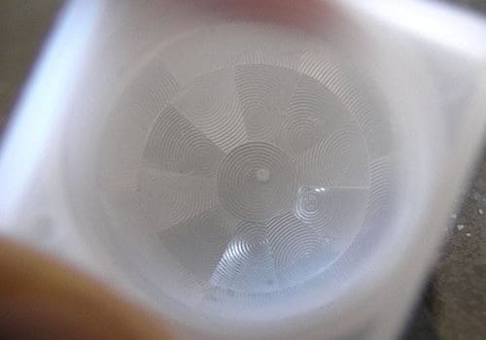
Passive Infrared Sensors (PIR)
The white plastic that you see on the PIR is called a Fresnel lens. The optic physics behind the Fresnel lens is a whole other interesting area to look into if you have time, but in this case, it gives the PIR sensor a much larger detection area making it more efficient. Figure shows the inside of the Fresnel lens, where you can see the “sections” on it.

Slide 24
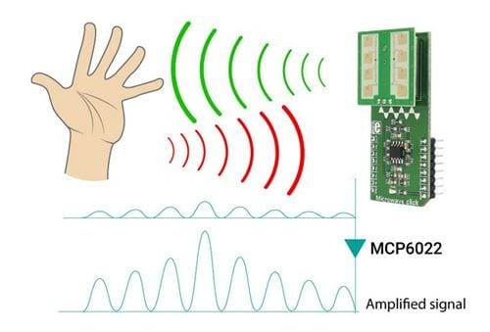
Microwave Motion Sensors
Microwave sensors emit continuous waves of microwave radiation to detect motion, similar to radar technology.
Working Principle:
They send out high-frequency radio waves and measure the reflection off objects. A frequency shift in the reflected waves indicates motion, activating the sensor.
Features:
Microwave sensors offer a larger coverage area than PIR sensors but are more expensive and susceptible to electrical interference.
Microwave sensors can cover a larger area than PIRs, but are more expensive and can be vulnerable to electrical interference. Its ability to penetrate material “see through walls” can cause frequent false alarms.

Slide 25
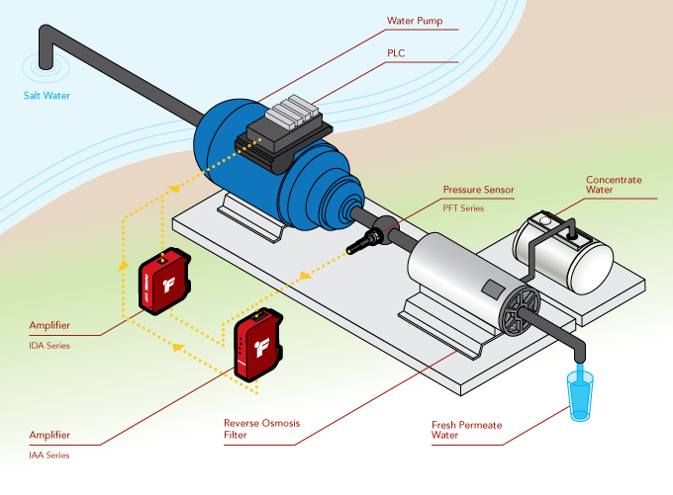
Pressure Sensors
Introduction:
Pressure sensors are integral devices that sense and measure pressure variations. Over centuries, pressure measurement has evolved from simple glass tube barometers to highly advanced sensors capable of precise and accurate measurements. Today, pressure sensors play a crucial role in various industries and applications, enabling predictive maintenance strategies and real-time monitoring of equipment conditions.
What is a pressure sensor?
A pressure sensor is a device designed to sense and measure pressure, defined as the force exerted over a specific area. These sensors facilitate specialized maintenance strategies, such as predictive maintenance, by collecting real-time data on equipment conditions. They help in predicting and addressing potential failure patterns by monitoring pressure fluctuations in pressurized assets.

Slide 26
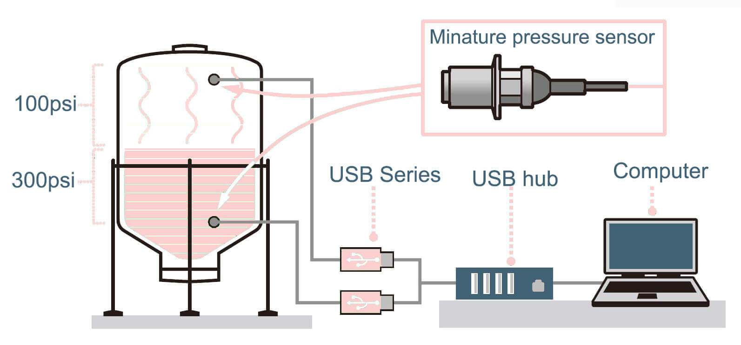
How Pressure Sensors Work
Pressure sensors operate by detecting physical changes in response to pressure differences and converting them into electrical signals. The process involves several steps:
Strain gauge conversion:
Common pressure sensors use strain gauges, mechanical apparatuses that undergo expansions or contractions in response to pressure. These changes are measured and calibrated to determine the applied pressure, which is then converted into electrical signals.
Recording electric signals:
The electrical signals generated by the strain gauge are recorded by the sensor, indicating the pressure readings. These signals vary in intensity based on the pressure applied to the sensor.

Slide 27
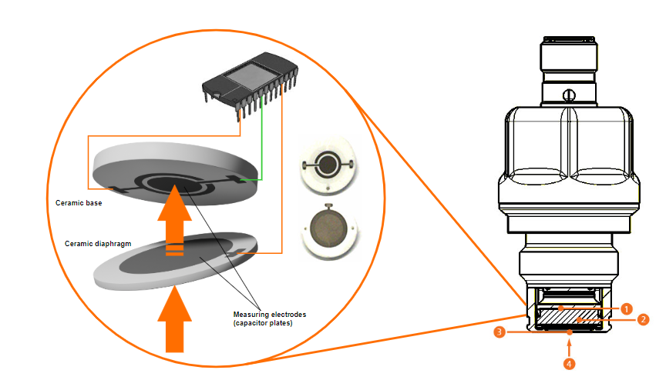
How Pressure Sensors Work
Integration with CMMS:
The pressure readings, typically measured in units such as pounds per square inch (psi) or Pascals (Pa), are transmitted to a Computerized Maintenance Management System (CMMS) in real-time. CMMS acts as a central hub for monitoring various assets across facilities.
Alerting maintenance teams:
CMMS alerts maintenance teams when pressure measurements deviate from specified levels, indicating potential risks or anomalies. Real-time data combined with mobile functionality provides teams with constant visibility into facility conditions.

Slide 28
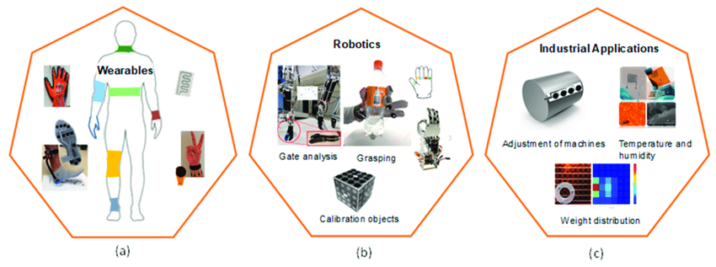
Popular Use Cases For Pressure Sensors
Pressure sensors find diverse applications across various industries, including:
Monitoring pipeline or hydraulic pressure
Transmitting pressure data across remote locations
Measuring vacuum pressure in advanced industrial processes
Energy conservation and emission testing
Precision manufacturing and technology industry applications
Monitoring fluid systems in manufacturing processes
Pressure sensors can save your business time and money: Implementing pressure sensors as part of a predictive maintenance strategy can lead to significant cost savings and operational efficiency. By detecting anomalies and potential failure patterns early, maintenance teams can take corrective action before breakdowns occur, reducing downtime and improving reliability.

Slide 29
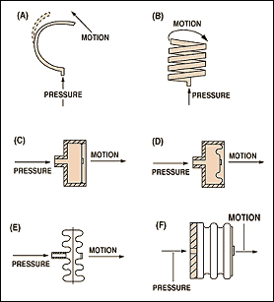
Types Of Pressure Sensors
Pressure sensors are categorized based on the method they use to sense pressure changes. Some common types include.
Strain gauge
Piezoelectric
Capacitive
Manometers
Vacuum pressure (e.g., Pirani sensor)
Bourdon tube
Aneroid barometer
Each type offers unique advantages and is suitable for specific applications, ranging from long-term monitoring to high-frequency dynamic measurements.

Slide 30
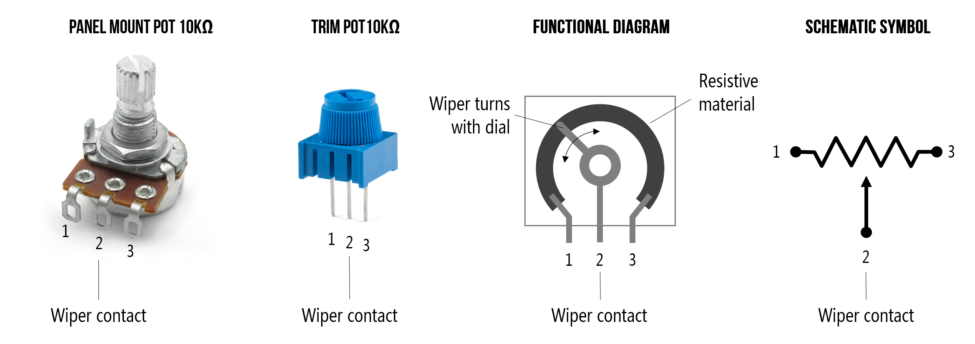
Potentiometer
The potentiometer is basically a long piece of uniform wire across which a standard cell is connected. In the actual design, the long wire is cut into several pieces, and it is placed side by side and connected at the ends with a thick metal strip. The current flowing through the wire can be varied using a variable resistance (rheostat) connected to the circuit. The resistance can be changed manually to measure the potential difference. The potential difference between any two points in a circuit is the amount of work done in bringing the charge from the first point to the second point. When there is a potential difference, there will be a current flow in the circuit.
The potentiometer is an instrument used to measure the unknown voltage by comparing it with the known voltage. It can be used to determine the emf and internal resistance of the given cell and also used to compare the emf of different cells. The comparative method is used by the potentiometer. The reading is more accurate in a potentiometer.

Slide 31
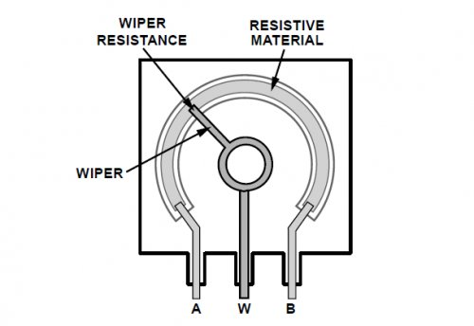
Potentiometer Sensitivity
The sensitivity of the potentiometer is the slightest change in the potential difference that a potentiometer can measure. The sensitivity of the potentiometer can be increased by decreasing the potential gradient, i.e., by increasing the length of the potentiometer wire.

Slide 32
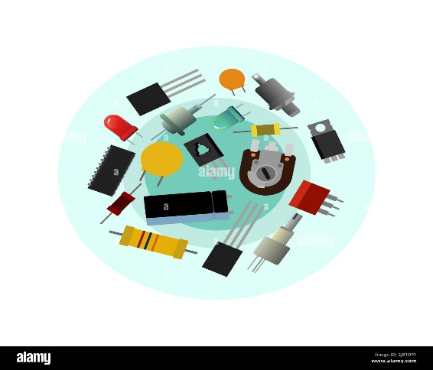
Output Device Of An Electric Circuit

Slide 33
Output Devices
Output devices in the realm of electric components serve the critical function of converting electrical signals into tangible outputs or actions, thereby facilitating communication between electronic systems and the external environment. These devices play a crucial role in various applications across industries, ranging from simple indicators to complex actuators.
Light Emitting Diodes (LEDs):
LEDs are semiconductor devices that emit light when an electric current passes through them. They are widely used as indicators to provide visual feedback in electronic circuits. LEDs come in various colors and sizes, making them versatile for different applications. They are energy-efficient, durable, and capable of operating in a wide range of conditions.
Liquid Crystal Displays (LCDs):
LCDs are flat panel displays that utilize liquid crystal technology to produce images or text. They consist of an array of pixels, each containing liquid crystal molecules that change orientation in response to an electric field. LCDs are commonly used in devices such as digital watches, calculators, computer monitors, and televisions due to their low power consumption and compact size.
Electromechanical Relays:
Relays are switches operated by an electromagnet. When an electric current flows through the coil of the relay, it generates a magnetic field that attracts an armature, causing the switch contacts to close or open. Relays are used to control high-power or high-voltage circuits using low-power signals. They are commonly employed in industrial automation, automotive systems, and electrical control panels.

Slide 34
Output Devices
Solenoid Valves:
Solenoid valves are electromechanical devices used to control the flow of fluids or gases in a system. They consist of a coil of wire (solenoid) surrounding a movable plunger. When an electric current passes through the solenoid, it creates a magnetic field that moves the plunger, opening or closing the valve. Solenoid valves are widely used in applications such as irrigation systems, HVAC (heating, ventilation, and air conditioning), and industrial machinery.
Piezoelectric Transducers:
Piezoelectric transducers convert electrical energy into mechanical vibrations or vice versa. When an electric voltage is applied to a piezoelectric material, it deforms, generating mechanical vibrations. Conversely, when mechanical pressure or stress is applied to the material, it produces an electric charge. Piezoelectric transducers are used in applications such as buzzers, ultrasonic sensors, and medical imaging devices.
Electric Motors:
Electric motors are devices that convert electrical energy into mechanical energy through the interaction of magnetic fields. They consist of coils of wire (armature) placed within a magnetic field generated by permanent magnets or electromagnets. When an electric current is passed through the coils, it creates a magnetic field that interacts with the external magnetic field, causing the motor to rotate. Electric motors are used in a wide range of applications, including robotics, industrial machinery, and automotive systems.

Slide 35
Output Devices
Actuators (e.g., Linear Actuators, Servo Motors):
Actuators are devices that convert electrical energy into linear or rotary motion. They are commonly used to control the position or movement of mechanical components in various systems. Linear actuators produce linear motion, while servo motors provide precise control over rotational motion. Actuators find applications in robotics, automation, aerospace, and automotive industries.
These output devices are essential components in electronic systems, enabling communication, control, and automation across diverse applications. Their functionalities and characteristics vary based on the specific requirements of each application, ranging from simple indication to complex motion control.

Slide 36
Detailed Explanation On Solenoid Valves, Piezoelectric Transducers, Electric Motors & Actuators

Slide 37
Solenoid Valves
Solenoid valves are used wherever fluid flow has to be controlled automatically. They are being used to an increasing degree in the most varied types of plants and equipment. The variety of different designs which are available enables a valve to be selected to specifically suit the application in question.
GENERAL
Solenoid valves are used wherever fluid flow has to be controlled automatically. They are being used to an increasing degree in the most varied types of plants and equipment. The variety of different designs which are available enables a valve to be selected to specifically suit the application in question.
CONSTRUCTION
Solenoid valves are control units which, when electrically energized or de-energized, either shut off or allow fluid flow. The actuator takes the form of an electromagnet. When energized, a magnetic field builds up which pulls a plunger or pivoted armature against the action of a spring. When de-energized, the plunger or pivoted armature is returned to its original position by the spring action.
VALVE OPERATION
According to the mode of actuation, a distinction is made between direct-acting valves, internally piloted valves, and externally piloted valves. A further distinguishing feature is the number of port connections or the number of flow paths ("ways").

Slide 38
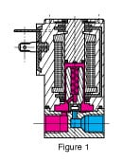
Solenoid VALVES
DIRECT-ACTING VALVES
With a direct-acting solenoid valve, the seat seal is attached to the solenoid core. In the de-energized condition, a seat orifice is closed, which opens when the valve is energized
DIRECT-ACTING 2- WAY VALVES
Two-way valves are shut-off valves with one inlet port and one outlet port (Fig. 1). In the de-energized condition, the core spring, assisted by the fluid pressure, holds the valve seal on the valve seat to shut off the flow. When energized, the core and seal are pulled into the solenoid coil and the valve opens. The electro-magnetic force is greater than the combined spring force and the static and dynamic pressure forces of the medium.

Slide 39
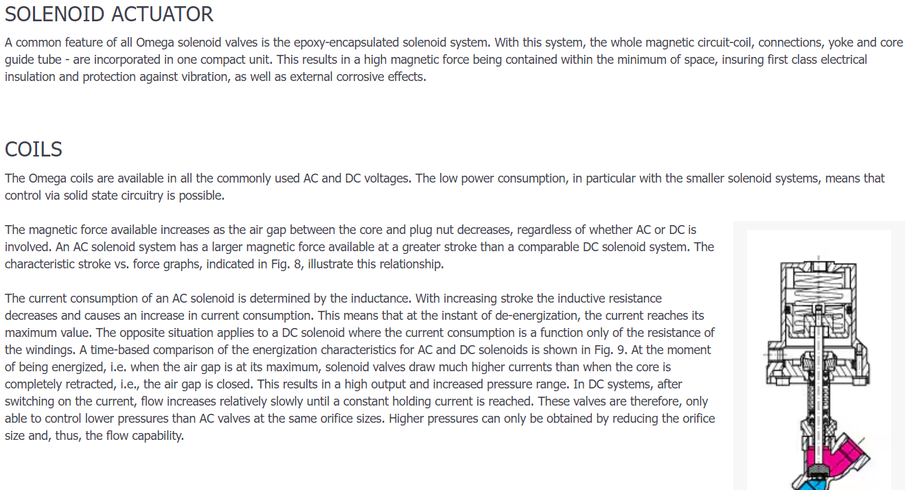
Solenoid Valves

Slide 40
Piezoelectric Transducer
In our everyday lives, we go over different circumstances where we need to quantify physical quantities like mechanical pressure applied on metal, temperature levels, Tension levels, and so on… For this multitude of utilizations, we really want a device that could gauge these obscure amounts in units and alignments natural to us. One such device which is generally helpful to us is the transducer. The transducer is an electrical gadget that can change over an actual amount as a corresponding electrical amount either as voltage or electrical current. From the huge pool of different types of transducers, this article means to make sense of piezoelectric transducers. They are used for the conversion of electrical charge into energy with the help of some solid material.
What is Piezoelectric Transducer?
The meaning of a Piezoelectric transducer is an electrical transducer which can change over any type of physical quantity into an electrical signal, which can be utilized for measurement. An electrical transducer which involves properties of piezoelectric materials for transformation of actual amounts into electrical signals is known as a piezoelectric transducer. It uses piezoelectric effect for the measurement of the changes in any quantity by conversion of the energy to electric charge.

Slide 41
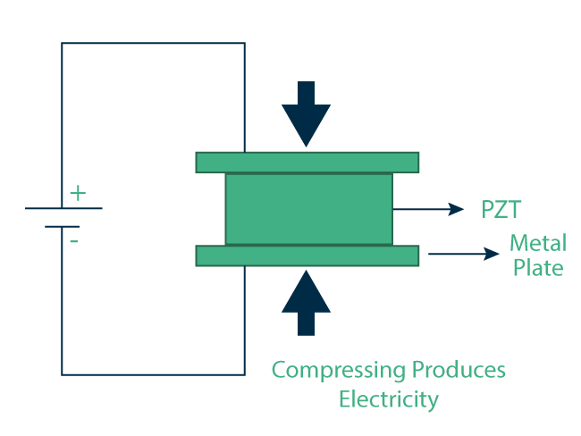
Working Of Piezoelectric Transducer
Piezoelectric Transducer works with the guideline of piezoelectricity. The essences of piezoelectric material, normal quartz, is covered with a thin layer of conducting material like silver. At the point when stress has applied the particles in the material move towards one of the leading surface while getting away from the other. This outcomes in the age of charge. This charge is utilized for adjustment of stress. The extremity of the delivered charge relies on the heading of the applied pressure. Stress can be applied in two structures as Compressive pressure and Ductile pressure as shown in figure
Piezoelectric Transducer Formula
The direction of the crystal likewise effects the amount of voltage generated. Crystal in a transducer can be set up in longitudinal position or cross over position.

Slide 42
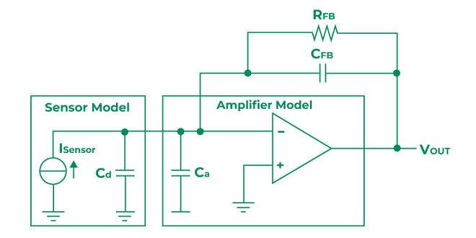
Piezoelectric Transducer Circuit
Here quartz crystal coated with silver is utilized as a sensor to generate a voltage when stress is applied on it. A charge enhancer is utilized to gauge the delivered charge without dissemination. To draw exceptionally low current the obstruction R1 is extremely high. The capacitance of the lead wire that associates the transducer and piezoelectric sensor additionally influences the alignment. So the charge intensifier is typically positioned extremely close to the sensor.
So in a piezoelectric transducer when mechanical pressure is applied a corresponding electric voltage is produced which is enhanced utilizing charge speaker and utilized for adjustment of applied pressure.

Slide 43
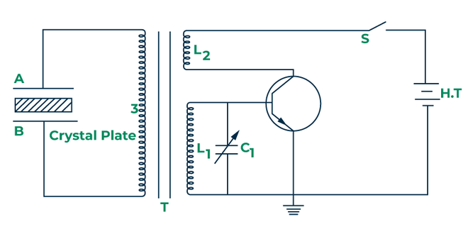
Piezoelectric Ultrasonic Transducer
The basic principle of its working is the converse piezoelectric effect. It produces the sound of that frequency which normally cannot be heard by the human. This sound is typically used in the vacuum cleaners. In this impact when power is applied to a piezoelectric material, it goes through actual disfigurements relative to applied charge. The circuit of the ultrasonic transducer is given
Quartz crystal is set between the two metal plates A and B that are connected through L3 of the transformer. The essential of the transformer is inductively coupled to the electronic oscillator. The coils L1 and L2, which structures auxiliary of the transformer, are associated with the electronic oscillator.
At the point when the battery is turned ON the oscillator creates high-recurrence substituting voltage beats with a frequency f=1÷(2π√L1C1). Because of this, an e.m.f is prompted in L3 which is moved to the quartz precious stone through plates An and B. Because of banter piezoelectric impact the precious stone beginnings contracting and growing on the other hand accordingly making mechanical vibrations. Resonance happens when the frequency of the electronic oscillator is equivalent to the regular frequency of the quartz. Right now, quartz produces longitudinal ultrasonic waves of large amplitude.

Slide 44
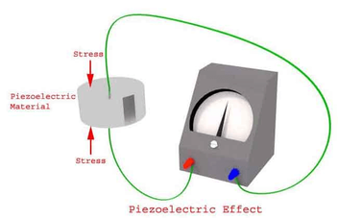
Piezoelectric Transducer Applications
Sensors: Used in accelerometers for measuring acceleration in devices like cell phones and automotive systems. Also used in pressure sensors for monitoring fluid pressure in pipelines and clinical devices.
Actuators: Utilized in precision positioning systems in microscopy and optics. Also used in inkjet printers to generate pressure waves for ejecting ink droplets.
Medical Devices: Critical component in clinical ultrasound devices for imaging internal structures in the body. Also used in surgical tools for precision cutting and tissue removal.
Energy Harvesting: Converts mechanical vibrations into electrical energy for powering small electronic devices or sensors.
Sonar Systems: Used in underwater sonar systems for navigation, communication, and detection of submerged objects.

Slide 45
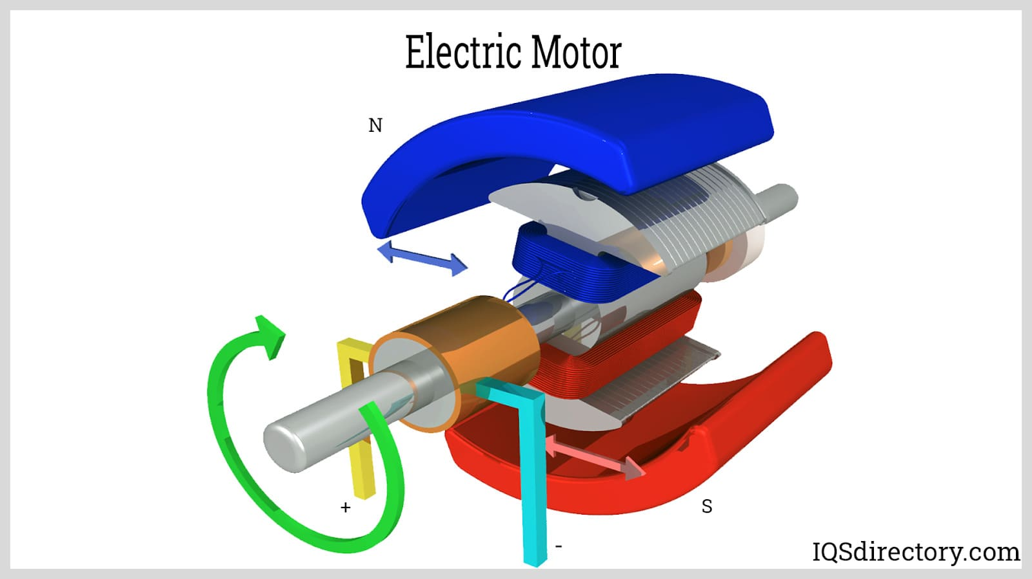
Electric Motor
An electric motor is an electric machine that converts electrical energy to mechanical energy. Most electric motors work via the interaction of the motor magnetic field and electrical current in a wound wire to produce force in the manner of torque supplied on the motor shaft. An electrical generator is identical mechanically to an electrical motor but functions with a reversed flow of energy, converting mechanical power to electrical power.
Electric motors may be driven by direct current (DC) supplies, like from rectifiers or batteries, or by alternating current (AC) supplies, like a power grid, electrical generators, or inverters. Electric motors can be categorized by concerns such as power supply type, application, construction, and type of movement output. They may be energized by DC or AC, be brushless or brushed, three-phase, two-phase, or single-phase, radial flux or axial, and can be liquid-cooled or air-cooled.
Standardized motors offer appropriate mechanical energy for industrial use. Applications include blowers and pumps, industrial fans, machine tools, power tools, household appliances, disk drives, and vehicles. Small motors can be found in electrical watches. In certain uses, like in regenerative braking in traction motors, electric motors may be utilized in reverse as generators that recover power that may otherwise be lost as friction and heat.

Slide 46

Construction Of An Electric Motor
Two mechanical components of electric motors are the stator, which is fixed and the rotor, which moves. It also has two electrical components, magnets set and an armature, one of them is attached to the stator and the other to the rotor, together making a magnetic circuit.
Field magnets produce a magnetic field that passes through the winding. These may be permanent magnets or electromagnets. The field magnet is generally on the stator and the winding on the rotor, but in other motor types these are reversed.
Electric Motor Bearings
Bearings support the rotor and allow the rotor to spin on its axis. The motor housing in turn supports the bearings.

Slide 47
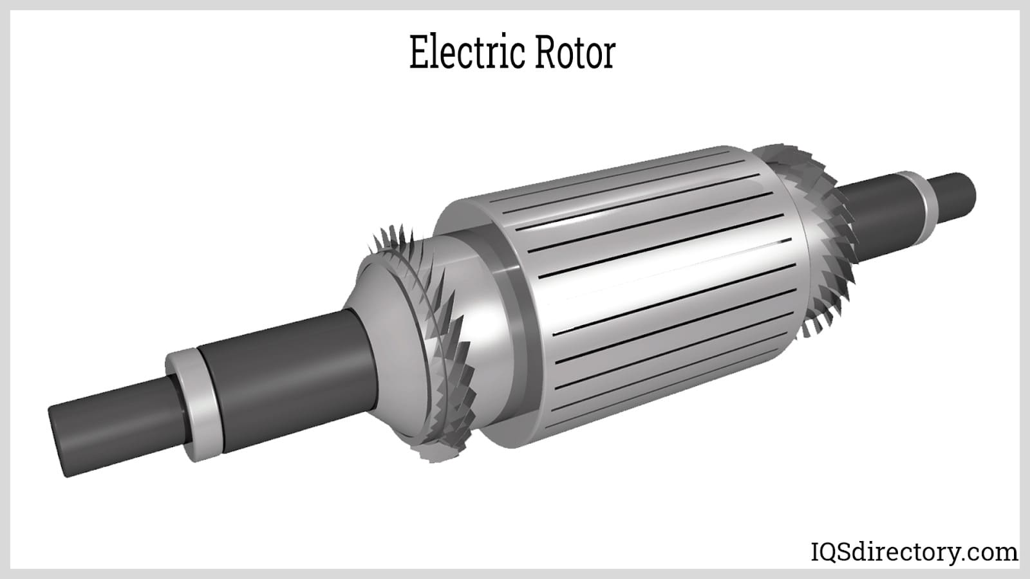
Electric Motor Rotor
The rotor is the mobile part that supplies the mechanical power. The rotor generally holds conductors which carry current and the stator magnetic field applies a force on to spin the shaft. Alternatively, other rotors have permanent magnets, and conductors are held by the stator. Permanent magnets give high efficiency over a bigger power range and working speed.
The air gap between the rotor and stator allows it to spin. The breadth of the gap has an important effect on the motor electrical properties. It is commonly made to be as small as possible, since a large gap produces weak performance. It is the primary source for the low power factor with which motors function. The energizing current rises and power factor reduces with the air gap, hence narrow gaps are better. Conversely, gaps which are very small may cause mechanical problems on top of losses and noise.
The motor shaft protrudes through bearings to the motor’s outer side, where the load is placed. Because the force of the load is applied beyond the furthest outer bearing, load is overhung.

Slide 48
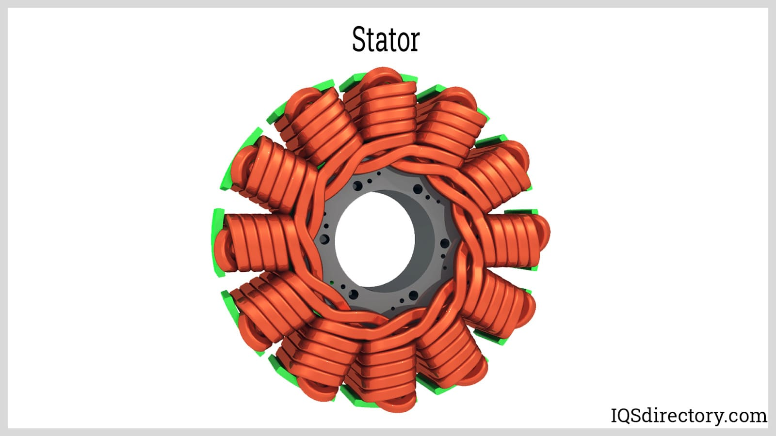
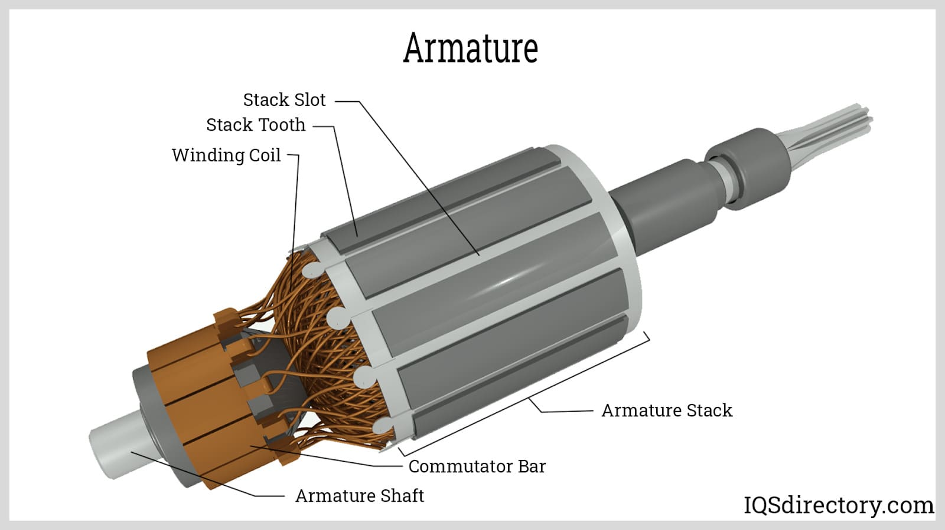
Electric Motor Stator
The stator surrounds the rotor, and generally holds the field magnets, these are either electromagnets consisting of wound wire on a ferromagnetic core of iron or permanent magnets. These produce a magnetic field that passes through the rotor winding, applying force on the winding. The stator iron core is made of many thin metallic sheets which have insulation from each other, known as laminations.
Lamination is utilized to lower energy loss which results if a solid core is utilized. Resin-packed motors, utilized in air conditioners and washing machines, utilize the damping attributes of plastic to lower vibration and noise.
Electric Motor Armature
The armature comprises wound wire on a ferromagnetic core. Current flowing through wire makes the magnetic field exert a Lorentz force onto it, rotating the rotor, which supplies the mechanical output. Windings are wires which are applied in coils, generally wrapped around a soft, laminated, iron, ferromagnetic core to produce magnetic poles when supplied with current.

Slide 49
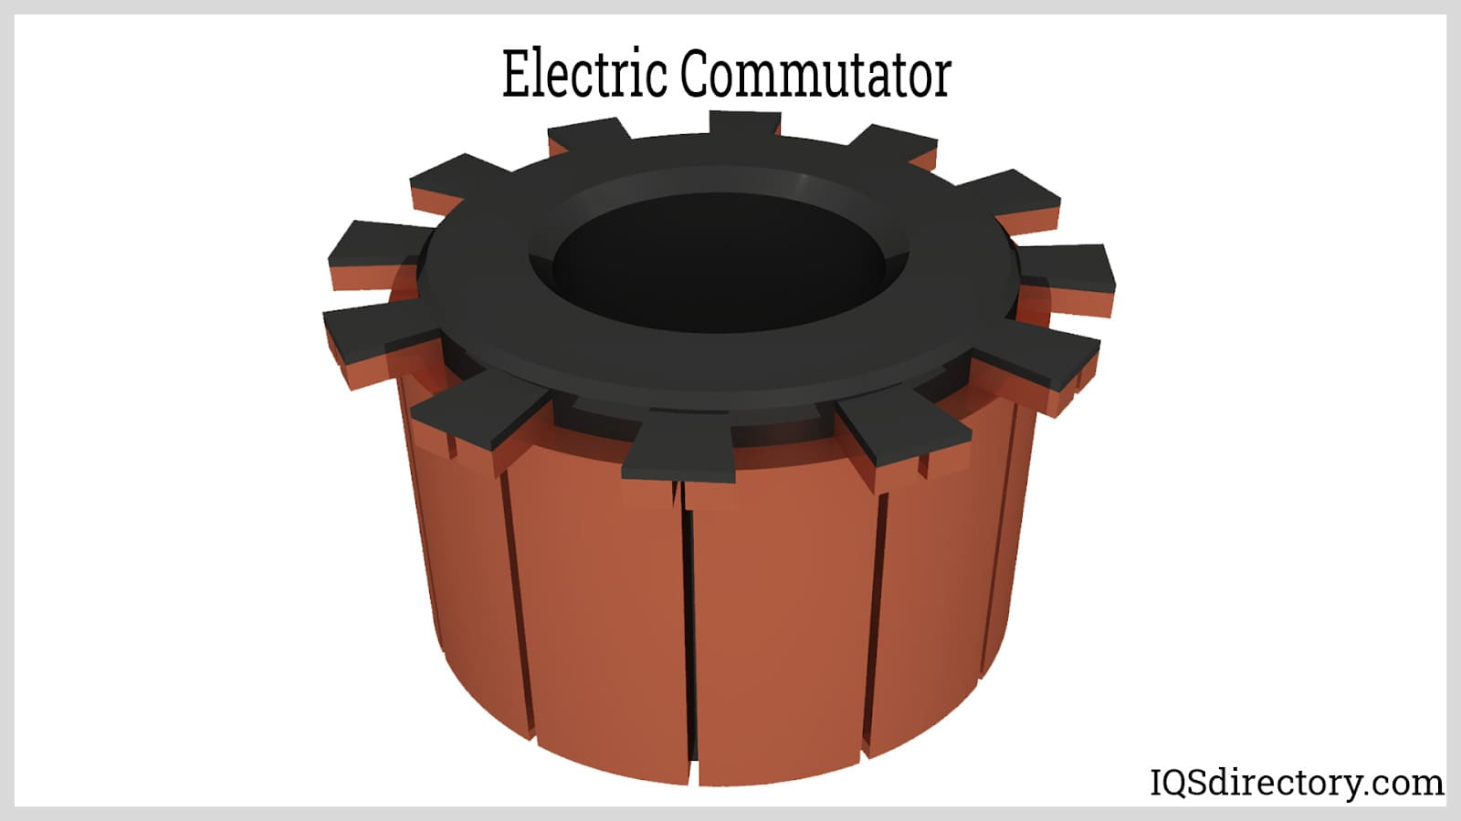
Electric Motor Commutator
A commutator is a rotary electric switch which supplies alternating or direct current to the rotor. It periodically reverses the current flow in the rotor winding as the shaft spins. It comprises a cylinder made of multiple metal contact sections on the armature. Electrical contacts named "brushes" consisted of a soft conductor material like carbon pressed onto the commutator. The brushes create sliding contacts with consecutive commutator sections as it spins, offering current onto the rotor.
The rotor wire wounds are connected to the commutator sections. The commutator reverses the direction of current periodically in the rotor windings with each a half turn (180°), hence torque exerted to the rotor is in the same direction always. Without this current reversal, the torque direction on every winding of the rotor would reverse on each half a turn, hence the rotor stops. Commutators are incompetent and commutator motors have been frequently replaced by brushless DC motors, induction motors and permanent magnet motors.

Slide 50
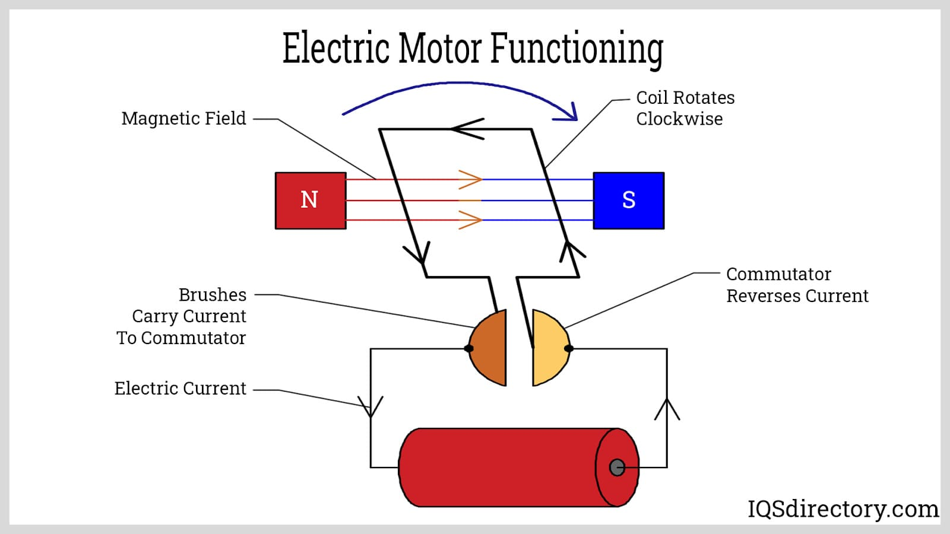
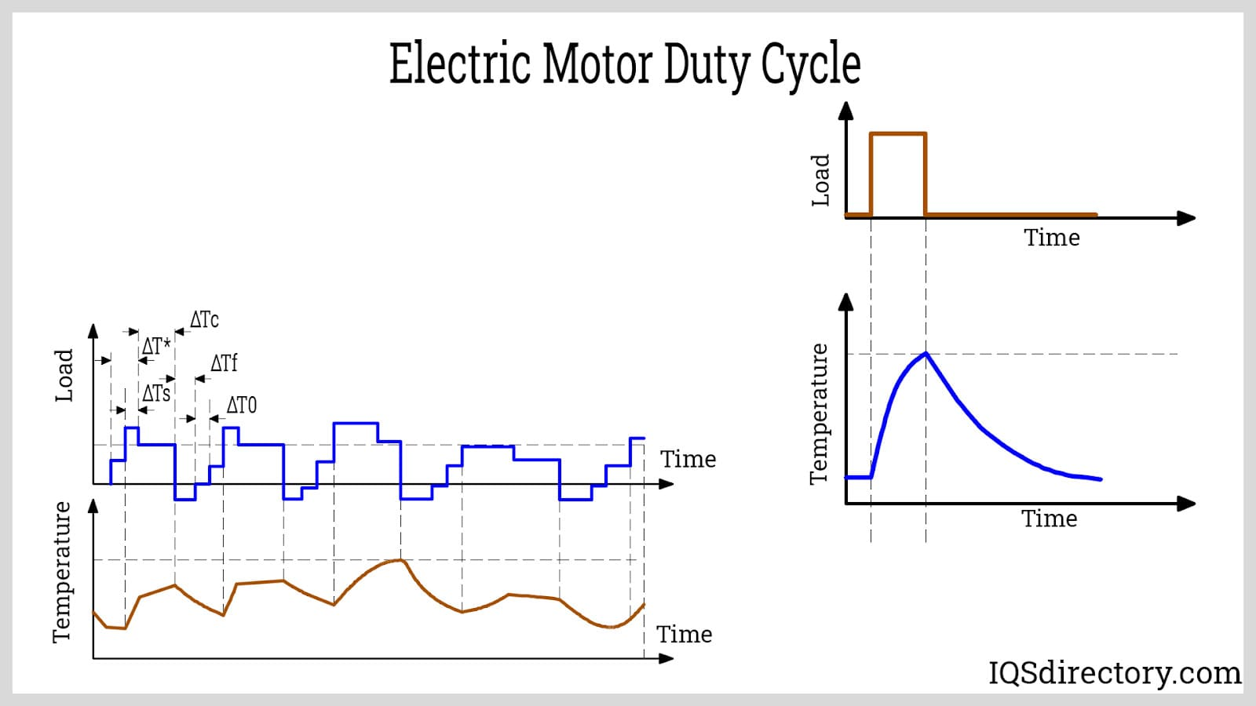
How An Electric Motor Functions
Electric motors function by changing electrical power (AC or DC) to mechanical power in order to produce motion. Force is created within a motor via the interaction between winding direct (DC) or alternating (AC) current and a magnetic field. As the current flow strength rises, so does the magnetic field strength. With Ohm's law (V = R*I) in mind, voltage should rise so as to maintain constant current as resistance rises.
Duty Cycle – It is pertinent to know a motor's duty cycle. If the application will be running continuously such that the motor reaches full operating temperature or in short spans for the motor to cool down completely between cycles. Motors that run discontinuously can sometimes use small motors with the same torque and speed, but run continuously.
Life Cycle – Applications that operate very discontinuously can at times get on with a short life cycle and high maintenance needs of Universal and DC motors. Applications that operate continuously and need to function for numerous hours without maintenance may need a brushless DC or an AC motor with a very long lifespan.

Slide 51
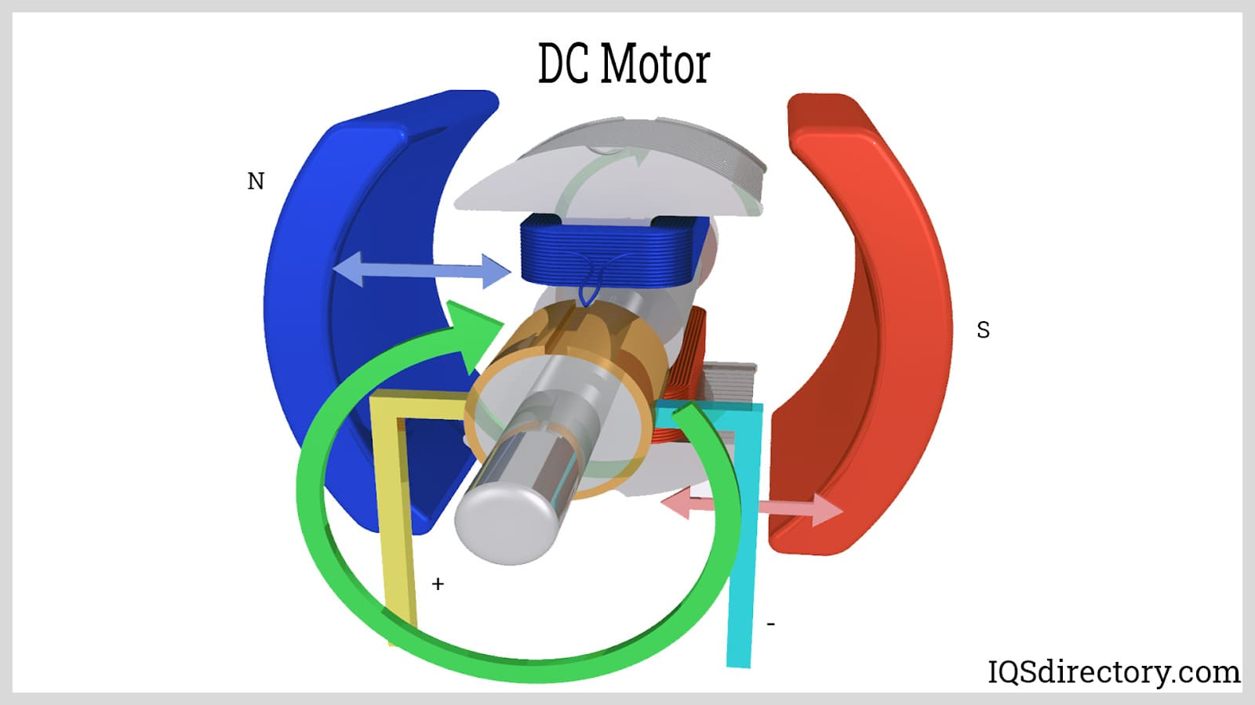
Types Of Electric Motors
DC Motors
A DC motor is any motor of a type of rotary electrical machine which converts electrical energy from direct current (DC) into mechanical energy. The most general types depend on the force created by magnetic fields. Almost all kinds of DC motors have some internal operation, either electronic or electromechanical, to change the current direction periodically in a part of the motor.
DC motors were the first kind of motor commonly utilized, as they can be powered from present direct current lighting energy distributing systems. DC motor speed may be controlled over a broad range, utilizing either a variable voltage supply or by altering the current strength in its field winding. Small DC motors are applied in appliances, toys, and tools. The universal DC motor can work on direct current but it is a light brushed motor utilized for portable appliances and power tools. Large DC motors are presently utilized in the propulsion of elevators and hoists, electric vehicles, and in drives for rolling mills for steel. With the arrival of power electronics replacement of DC motors with AC motors has been made conceivable in many applications.

Slide 52
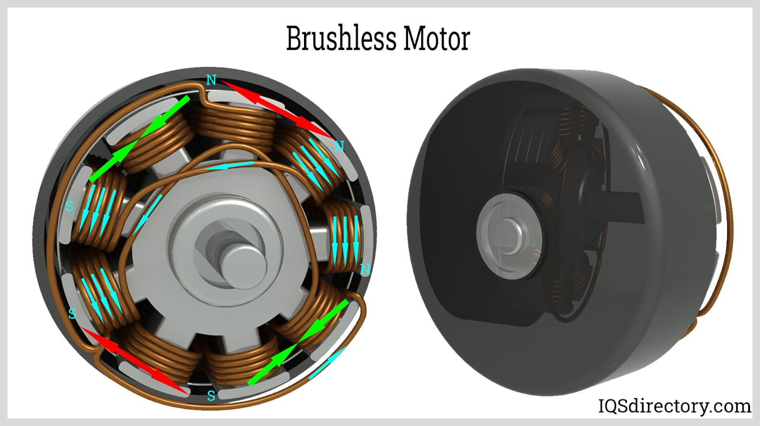
Brushless Motor
A brushless motor is a type of DC motor (BL motor or BLDC motor), also referred to as an electronic commutated motor (EC or ECM motor). It could also be called a synchronous DC motor. This is a motor utilizing direct current electric power. It utilizes an electronic controller to turn on DC currents to the windings creating a magnetic field that successfully rotates in space and the permanent magnet rotor rotates by following. The controller adjusts the amplitude and phase of the DC current pulse to control the torque and speed of the motor. This control mechanism is a substitute for the brushes or mechanical commutator utilized in numerous conventional electric motors.
The manufacture of a brushless DC motor is generally similar to a permanent magnet DC motor, but may also be an asynchronous/induction motor, or switched reluctance motor. They may also utilize a neodymium magnet and be out-runners (the rotor surrounds the stator), in-runners (the stator surrounds the stator), or axial (the stator and rotor are parallel and flat).
The benefits of brushless motors over a brushed motor are high speed, high power-to-weight ratio, close to instantaneous torque and speed control (rpm), low maintenance, and high efficiency. Brushless motors find use in computer peripherals (printers, disk drives), portable power devices, and vehicles varying from automobiles to model aircraft. In current washing machines, brushless motors have enabled the replacement of gearboxes and rubber belts using a direct-drive design.

Slide 53
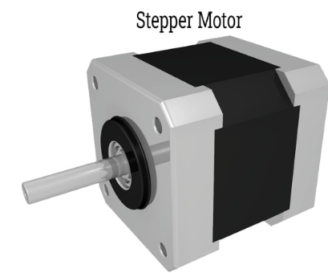
Stepper Motor
A stepper motor, also referred to as a stepping motor or step motor, is a brushless DC motor that divides a full revolution into a number of equivalent steps. The motor's position may be instructed to change and hold at one of the equal steps without using any positional sensor for feedback, as long as the motor is appropriately sized for the use in respect to speed and torque. Brushed DC motors continuously rotate when direct voltage is put on their terminals. A stepper motor is known for its characteristic of conversion of a chain of input pulses square waves to precisely defined increments in the shaft’s rotational point. Each pulse spins the shaft in a fixed angle.
Stepper motors ultimately have numerous toothed electromagnets placed as a stator surrounding a central rotor, which is a gear-shaped iron piece. The electromagnets are powered by a microcontroller or an external driver circuit.
To make the shaft first rotate, one electromagnet is powered, which attracts the gear's teeth magnetically. When the teeth are aligned to the initial electromagnet, they are marginally offset from the following electromagnet. This means when the following electromagnet is switched on and the initial is switched off, the gear spins a little to align with the following one. From there the procedure is repeated. Each of those spins is called a "step," with an integer number of steps completing a full rotation. In that way, a motor may be turned using a precise angle.

Slide 54
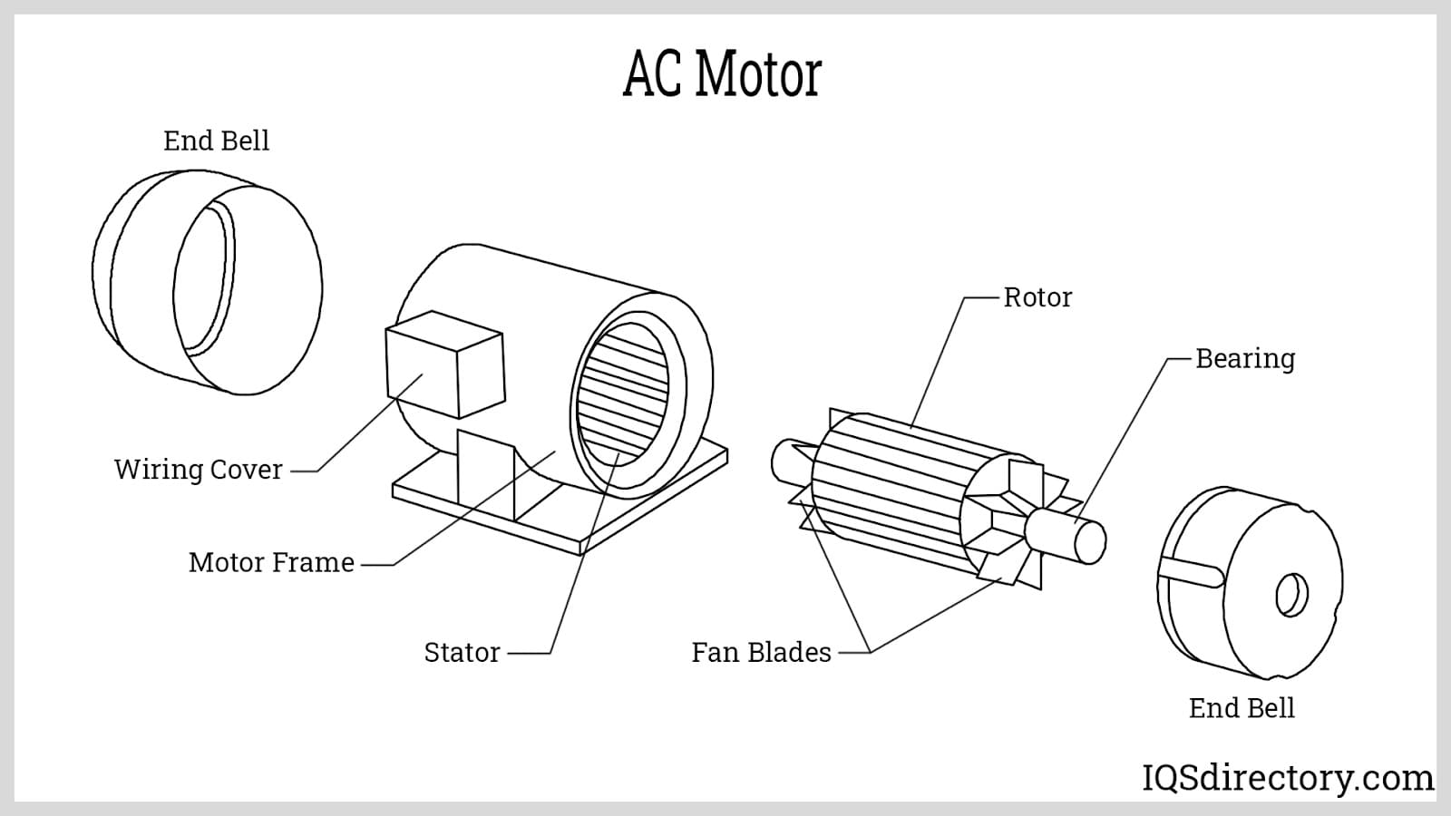
AC Motors
An AC motor is an electric motor powered by an alternating current (AC). The AC motor generally comprises two primary parts: an outer stator with coils energized by an alternating current to create a spinning magnetic field. An inner rotor attached to the shaft creates a second spinning magnetic field. The rotor’s magnetic field could be created by reluctance saliency, permanent magnets, or AC or DC electrical windings.
Less popular, AC linear motors function on similar rules as rotating motors but they have their moving and stationary components laid out in a straight line set up, creating linear movement instead of rotation.
The two primary kinds of AC motors are synchronous motors and induction motors. The induction or asynchronous motor always depends on a small variance in speed between the rotor shaft speed and the stator spinning magnetic field called slip which induces rotor current in the AC winding of the rotor. Therefore, the induction motor can’t create torque close to synchronous speed where slip (induction) ceases to exist or is irrelevant. In comparison, a synchronous motor doesn’t depend on induction of slip for functioning and utilizes either salient poles (projecting magnetic poles), permanent magnets, or an individually excited rotor winding. The synchronous motor creates its ranked torque at accurately synchronous speed. The brushless wound-rotor double supplied synchronous motor mechanism has an individually excited rotor winding which does not depend on the rules of slip induced current. The brushless wound-rotor double supplied motor is a synchronous motor which can work exactly at the power source frequency. Other kinds of motors involve eddy current motors and DC and AC mechanically commutated machinery where speed relies on winding connection and voltage.

Slide 55
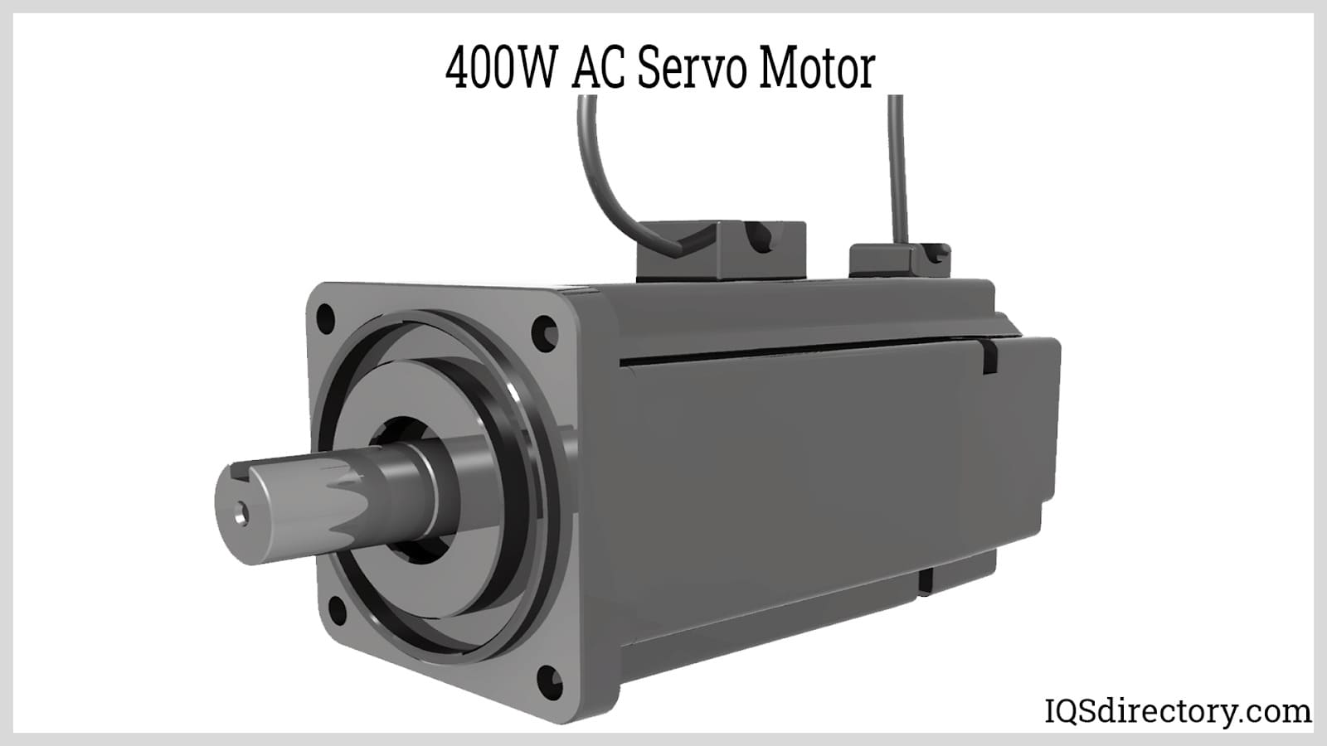
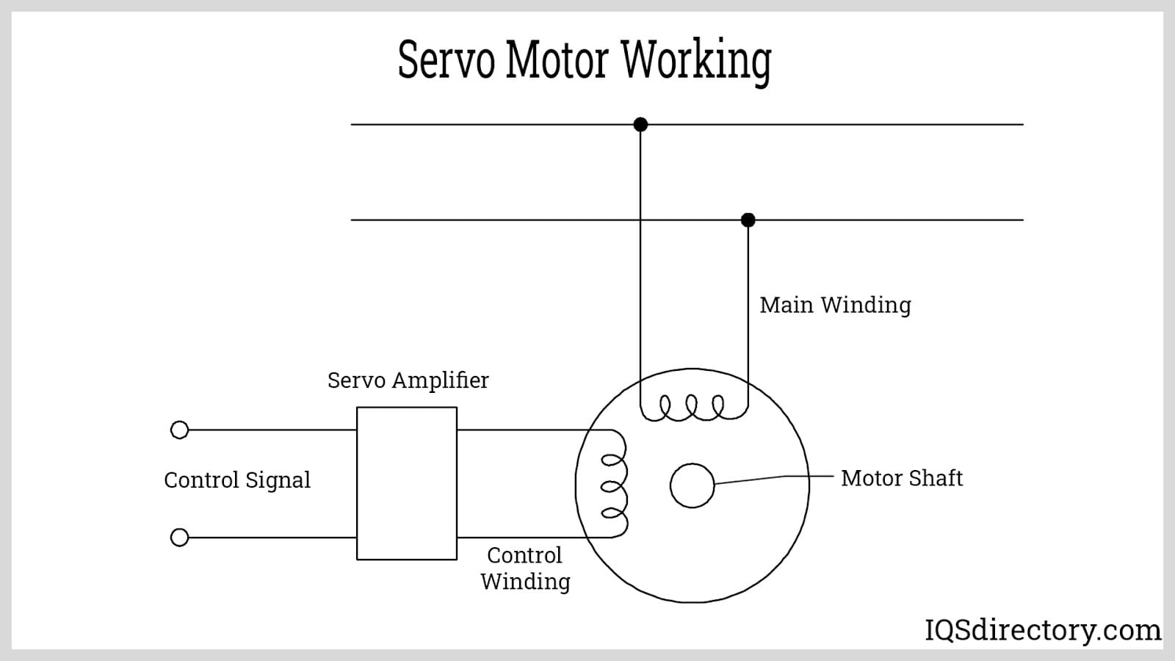
Servo Motors
A servomotor or servo motor is a linear actuator or rotary actuator which enables precise control of linear or angular position, acceleration, and velocity. It comprises an appropriate motor coupled with a sensor for feedback of position. It also needs a relatively complex controller, usually a dedicated device designed especially for usage with servomotors.
Servomotors aren’t an exact class of motors, though the name servomotor is often used to state a motor appropriate for usage in a closed-loop control system. Servomotors are utilized in applications like CNC mac
The type of motor used is not important to a servo motor and various types can be utilized. At the most basic, brushed DC motors (permanent magnet) are utilized, owing to their low cost and simplicity. Small industrial servo motors are generally brushless motors electronically commutated. For big industrial servo motors, AC induction motors are generally used, at times with variable frequency drives (VFD) to allow speed control. For ultimate performance in compact packages, brushless AC motors using permanent magnets are utilized, effectively big versions of brushless DC motors. hinery, robotics, and automated manufacturing.

Slide 56
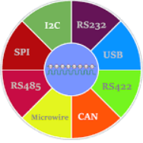
COMMUNICATION & PROTOCOLS
"Navigating the Web of Connection:
Exploring Communication and Protocols"

Slide 57
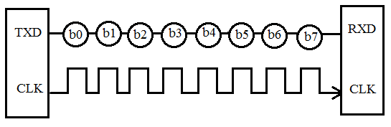
Exploring Serial & Wireless Communication Protocols
Serial Communication Protocols
Before starting with Serial Communication Protocols, Let’s break the terminology in three parts. The communication is very well known terminology which involves the exchange of information between two or more mediums. In embedded systems, the communication means the exchange of data between two microcontrollers in the form of bits. This exchange of data bits in microcontroller is done by some set of defined rules known as communication protocols. Now if the data is sent in series i.e. one after the other then the communication protocol is known as Serial Communication Protocol. More specifically, the data bits are transmitted one at a time in sequential manner over the data bus or communication channel in Serial Communication.
There are different types of data transfer available in the digital electronics such as serial communication and parallel communication. Similarly the protocols are divided into two types such as Serial Communication Protocol and Parallel Communication Protocols. Examples of Parallel Communication Protocols are ISA, ATA, SCSI, PCI and IEEE-488. Similarly there are several examples of Serial Communication Protocols such as CAN, ETHERNET, I2C, SPI, RS232, USB, 1-Wire, and SATA etc.

Slide 58
Types Of Communication Protocols
The different types of Serial Communication Protocols will be discussed. Serial communication is the most widely used approach to transfer information between data processing peripherals. Every electronics device whether it is Personal Computer (PC) or Mobile runs on serial communication. The protocol is the secure and reliable form of communication having a set of rules addressed by the source host (sender) and destination host (receiver) similar to parallel communication.
The different types of Serial Communication Protocols will be discussed. Serial communication is the most widely used approach to transfer information between data processing peripherals. Every electronics device whether it is Personal Computer (PC) or Mobile runs on serial communication. The protocol is the secure and reliable form of communication having a set of rules addressed by the source host (sender) and destination host (receiver) similar to parallel communication.

Slide 59

Modes In Serial Communication
Transmission Modes in Serial Communication
As already said above that in serial communication data is sent in the form of bits i.e. binary pulses and it is well known that, binary one represents the logic HIGH and zero represents the logic LOW. There are several types of serial communication depending on the type of transmission mode and data transfer. The transmission modes are classified as Simplex, Half Duplex and Full Duplex.
Simplex Method:
In simplex method either of the medium i.e sender or receiver can be active at a time. So if the sender is transmitting the data then receiver can only accept and vice versa. So simplex method is one-way communication technique. The well-known examples of simplex method are Television and Radio.
Half Duplex Method:
In half duplex method both sender and receiver can be active but not at the same time. So if the sender is transmitting then receiver can accept but cannot send and similarly vice versa. The well-known examples of the half duplex is the internet where the user sends a request for a data and the gets it from server.

Slide 60
Modes In Serial Communication
FULL DUPLEX METHOD:
In full duplex method, both receiver and transmitter can send data to each other at the same time. The well-known example is mobile phone.
Apart from this, for appropriate data transmission, the clock plays important role and it is one of the primary source. Malfunction of the clock results in unexpected data transmission even sometimes data loss. So, the clock synchronization becomes very important when using serial communication.
CLOCK SYNCHRONIZATION:
The clock is different for serial devices and it is classified in two type viz. Synchronous Serial Interface and Asynchronous Serial Interface.
SYNCHRONOUS SERIAL INTERFACE:
It is a point-to-point connection from a master to slave. In this type of interface, all the devices use single CPU bus to share data and clock. The data transmission becomes faster with same bus to share clock and data. Also there is no mismatch in baud rate in this interface. In transmitter side, there is a shift of the data onto serial line providing the clock as a separate signal as there is no start, stop and parity bits are added to data. In receiver side, the data is being extract using the clock provided by the transmitter and converts the serial data back to the parallel form. The well-known examples are I2C and SPI.

Slide 61


Modes In Serial Communication
ASYNCHRONOUS SERIAL INTERFACE:
In asynchronous Serial Interface, the external clock signal is absent. The Asynchronous Serial Interfaces can be seen in mostly in long distance applications and are a perfect fit for the stable communication. In asynchronous Serial Interface the absence of external Clock Source makes it rely on several parameters such as Data Flow Control, Error Control, Baud Rate Control, Transmission Control and Reception Control. On the transmitter side, there is a shifting of parallel data onto the serial line using its own clock. Also it adds the start, stop and parity check bits. On the receiver side, the receiver extracts the data using its own clock and convert the serial data back to the parallel form after stripping off the start, stop, and parity bits. The well-known examples are RS-232, RS-422 and RS-485.

Slide 62
Other Terms Related To Serial Communication
Apart from Clock Synchronization there are certain things to remember when transferring data serially such as Baud Rate, Data bit selection (Framing), Synchronisation and error checking. Let’s discuss these terms in brief.
Baud Rate: Baud rate is rate at which the data is transferred between the transmitter and receiver in the form of bits per second (bps). The most commonly used baud rate is 9600. But there are other selection of baud rate such as 1200, 2400, 4800, 57600, 115200. The more the baud rate will be fats the data will be transferred at a time. Also for the data communication the baud rate has to be same for both transmitter and receiver.
Framing: Framing is referred to the number of data bits to be sent from transmitter to receiver. The number of data bits differs in case of application. Most of the application uses 8 bits as the standard data bits but it can be selected as 5, 6 or 7 bits also.

Slide 63
Other Terms Related To Serial Communication
Synchronisation: Synchronization Bits are important to select a chunk of data. It tells the start and end of the data bits. The transmitter will set start and stop bits to the data frame and the receiver will identify it accordingly and do the further processing.
Error Control: The error control plays an important role while serial communication as there are many factors which affects and adds the noise in the serial communication. To get rid of this error the parity bits are used where parity will check for even and odd parity. So if the data frame contains the even number of 1’s then it is known as even parity and the parity bit in the register is set to 1. Similarly if the data frame contains odd number of 1’s then it is known as odd parity and clears the odd parity bit in the register.
Protocol is just like a common language that system uses to understand the data. As described above, the serial communication protocol is divided into types i.e. Synchronous and Asynchronous.

Slide 64

SPI Protocol
The Serial Peripheral Interface (SPI) is a synchronous interface which allows several SPI microcontrollers to be interconnected. In SPI, separate wires are required for data and clock line. Also the clock is not included in the data stream and must be furnished as a separate signal. The SPI may be configured either as master or as a slave. The four basic SPI signals (MISO, MOSI, SCK and SS), Vcc and Ground are the part of data communication. So it needs 6 wires to send and receive data from slave or master. Theoretically, the SPI can have unlimited number of slaves. The data communication is configured in SPI registers. The SPI can deliver up to 10Mbps of speed and is ideal for high speed data communication.

Slide 65

I2C SERIAL COMMUNICATION
Inter integrated circuit (I2C) two-line communication between different ICs or modules where two lines are SDA (Serial Data Line) and SCL (Serial Clock Line). Both the lines must be connected to a positive supply using a pull up resistor. I2C can deliver speed up to 400Kbps and it uses 10 bit or 7 bit addressing system to target a specific device on the i2c bus so it can connect up to 1024 devices. It has limited length communication and is ideal for onboard communication. I2C networks are easy to setup since it uses only two wires and new devices can simply be connected to the two common I2C bus lines. Same like SPI, microcontroller generally have I2C pins to connect any I2C device:

Slide 66

USB & CAN
USB
USB (Universal Serial Bus) is widely protocol with different versions and speeds. A maximum of 127 peripherals can be connected to a single USB host controller. USB acts as "plug and play" device. The USB are used in almost devices such as keyboards, printers, media devices, cameras, scanners and mouse. It is designed for easy installation, faster data rated, less cabling and hot swapping. It has replaced the bulkier and slower serial and parallel ports. USB uses differential signalling to reduce interference and allow high-speed transmission over a long distance.
A differential bus is built with two wire, one of represents the transmitted data and the other its complement. The idea is that the 'average' voltage on the wires does not carry any information, resulting in less interference. In USB, the devices are allowed to draw a certain amount of power without asking the host. USB uses only two wires to for data transfer and are faster than the serial and parallel interface. USB versions supports different speeds such as 1.5Mbps (USB v1.0), 480 Mbps (USB2.0), 5Gbps (USB v3.0). Length of individual USB cable can reach up to 5 meters without a hub and 40 meters with hub.

Slide 67

USB & CAN
Control Area Network (CAN) bus is a serial communication protocol that allows devices to exchange data in a reliable and efficient way. It is widely used in vehicles, working like a nervous system to connect ECUs in the vehicle.
CAN bus was originally designed for automotive applications by Bosch in the 1980s. It is a multi-master, multi-slave, half-duplex, and fault-tolerant protocol that fits well with the requirements of automotive applications. It is simple, low-cost, and reliable and can be used in harsh environments. The CAN bus provides one point of entry for all the ECUs in the vehicle, which makes it easy to connect and diagnose.
CAN bus data can provide valuable insights into the performance and status of the connected devices. However, collecting and processing CAN bus data can be challenging due to the high data rate, low bandwidth, and variable network conditions.

Slide 68

MICROWIRE & ASYNCHRONOUS SERIAL PROTOCOLS
Microwire
MICROWIRE is a 3Mbps [full-duplex] serial 3-wire interface essentially a subset of the SPI interface. Microwire is a serial I/O port on microcontrollers, so the Microwire bus will also be found on EEPROMs and other Peripheral chips. The 3 lines are SI (Serial Input), SO (SerialOutput) and SK(Serial Clock). The Serial Input (SI) line to the microcontroller, SO is the serial output line, and SK is the serial clock line. Data is shifted out on the falling edge of SK, and is valued on the rising edge. SI is shifted in on the rising edge of SK. An additional bus enhancement to MICROWIRE is called MICROWIRE/Plus. The main difference between the two buses seems to be that MICROWIRE/Plus architecture within the microcontroller is more complex. It supports speeds up to 3Mbps.

Slide 69
ASYNCHRONOUS SERIAL PROTOCOLS
The asynchronous type of serial protocols are very essential when it comes to longer distance reliable data transfer. Asynchronous communication does not require a timing clock that is common to both devices. Each device independently listens and sends digital pulses that represent bits of data at an agreed-upon rate. Asynchronous serial communication is sometimes referred to as Transistor-Transistor Logic (TTL) serial, where the high voltage level is logic 1, and the low voltage equates to logic 0. Almost every microcontroller on the market today has at least one Universal Asynchronous Receiver-Transmitter (UART) for serial communication. The examples are RS232, RS422, RS485 etc.
RS232
The RS232 (Recommended Standard 232) is very common protocol used to connect different peripherals such as Monitors, CNCs etc. The RS232 comes in male and female connectors. The RS232 is point-to-point topology with maximum one device connected and covers distance up to 15 meters at 9600 bps. Information on the RS-232 interface is transmitted digitally by logical 0 and 1. The logical "1" (MARK) corresponds to a voltage in the range from -3 to -15 V. The logical "0" (SPACE) corresponds to a voltage in the range from +3 to +15 V. It comes in DB9 connector which has 9 pinouts such as TxD, RxD, RTS, CTS, DTR, DSR, DCD, GND.

Slide 70
RS422 & RS485
RS422
The RS422 is similar to RS232 which allows to simultaneously send and receive messages on separate lines but uses a differential signal for this. In the RS-422 network, there can only be one transmitting device and up to 10 receiving devices. The data transfer speed in RS-422 depends on the distance and can vary from 10 kbps (1200 meters) to 10 Mbps (10 meters). The RS-422 line is 4 wires for data transmission (2 twisted wires for transmission and 2 twisted wires for receiving) and one common GND ground wire. The voltage on the data lines can be in the range from -6 V to +6 V. The logical difference between A and B is greater than +0.2 V. Logical 1 corresponds to the difference between A and B less than -0.2 V. The RS-422 standard does not define a specific type of connector, usually it can be a terminal block or a DB9 connector.
RS485
Since RS485 uses multi-point topology, it is most used in the industries and are industry preferred protocol. RS422 can connect 32 line drivers and 32 receivers in a differential configurations but with the help of additional repeaters and signal amplifiers up to 256 devices. The RS-485 does not define a specific type of connector, but it is often a terminal block or a DB9 connector. The speed of operation also depends on the length of the line and can reach 10 Mbit / s at 10 meters. The voltage on the lines is in the range from -7 V to +12 V. There are two types of RS-485 such as half duplex mode RS-485 with 2 contacts and full duplex mode RS-485 with 4 contacts. To learn more about using RS485 with other microcontrollers.

Slide 71

Subscriber Identity Module
SIM (SUBSCRIBER IDENTITY MODULE):
Purpose: Authentication and identification of mobile subscribers on a cellular network.
USES:
Authenticates the user on the network, allowing access to voice and data services.
Stores subscriber information, including contacts and text messages.
Examples:
Used in mobile phones, tablets, and other cellular devices.
Essential for secure and authorized access to cellular networks.

Slide 72

LONG-TERM EVOLUTION
LTE (LONG-TERM EVOLUTION):
Purpose: High-speed wireless communication for mobile devices.
USES:
Enables fast internet access and data transfer on mobile devices.
Supports multimedia streaming, online gaming, and other high-bandwidth applications.
EXAMPLES:
Utilized in smartphones, tablets, mobile hotspots, and other devices for high-speed mobile internet access.
Critical for 4G LTE networks that provide improved data transfer speeds compared to previous generations.

Slide 73

BLUETOOTH LOW ENERGY
BLE (BLUETOOTH LOW ENERGY):
Purpose: Efficient wireless communication with low power consumption for short-range connections.
USES:
Connects and exchanges data between devices in proximity.
Ideal for IoT devices, wearables, and applications with periodic data exchange.
EXAMPLES:
Fitness trackers, smartwatches, health monitoring devices.
Smart home devices like door locks, light bulbs, and sensors.

Slide 74

ZIGBEE
Purpose:
Low-power, short-range wireless communication for IoT devices in a mesh network.
USES:
Creates a mesh network for connecting and controlling smart devices.
Suitable for applications where low data rate and low power consumption are essential.
EXAMPLES:
Home automation systems controlling lights, thermostats, and smart plugs.
Industrial applications for monitoring and controlling sensors in a wireless mesh.

Slide 75

LONG RANGE
Purpose:
Long-range, low-power wireless communication for IoT applications.
Uses:
Connects devices over long distances with minimal power consumption.
Ideal for applications requiring intermittent, low-data-rate communication.
Examples:
Agricultural sensors for monitoring soil conditions and crop health.
Smart city applications, such as monitoring parking spaces and waste bins.

Slide 76

ESPNOW
ESP-NOW is a protocol by Espressif for low-power, peer-to-peer communication between ESP8266 or ESP32 devices, enabling quick data exchange without Wi-Fi. Here's how it works:
Peer-to-Peer Communication: Allows direct device-to-device communication, ideal for decentralized setups like home automation.
Low Power Consumption: Efficient operation for battery-powered devices, optimizing energy usage and extending battery life.
High Throughput: Despite low power, achieves fast data transfer rates suitable for reliable communication.
Simple Setup: Easy configuration using ESP-IDF or Arduino frameworks, facilitating straightforward device communication.
Security: Offers basic encryption for data transmission, ensuring protection against unauthorized access to sensitive information.

Slide 77

BEGINNERS GUIDE TO ARDUINO IDE & ARDUINO PROGRAMMING

Slide 78

What Is The Arduino IDE?
As we know we need a text/code editor to write the code, a compiler to convert that code to machine code or binary files so that the microcontroller can understand, and also programming software to load these firmware files onto the microcontroller. When we combine all these with some additional features like debugging support, console support, etc., that's what we call an IDE (Integrated Development Environment) or in simple terms the Arduino Software. Arduino IDE, as the name states, is a development IDE for the Arduino boards. It consists of a feature-rich code editor, compiler, programmer, serial console, serial plotter, and many other features. It is simple and easy to use.
Arduino IDE is cross-platform, and it can run on operating systems from Microsoft, Linux, and Windows. Furthermore, you can program the boards using the Arduino IDE and Arduino Language, which is a derivative of C/C++.

Slide 79

How To Install Arduino IDE?
Download the installer for your operating system from the above-given link.
Once the download is done open the .exe file.
Agree to the licence agreement and select if the IDE should be installed to all users or not and click on “Next” to continue.
Select the location in which you want the IDE to install if you want to change the location or keep it default and click on “Install”
Wait for the installer to finish installation, and click on “Close”.

Slide 80

Arduino Driver Installation
One common question that everyone gets when starting with Arduino Software is about the board driver installation. But the truth is that you don’t have to worry about it. The installer will load all the necessary files to the computer and will install the drivers automatically as soon as you connect the board to the computer.
Connecting Arduino Board to the Computer
To connect the Arduino board to the computer, simply connect the appropriate cable to the Arduino board and connect the other end to the USB port of your PC. The power LED will glow indicating the board is powered. The system will automatically install the driver for the board.

Slide 81

Arduino IDE – Basics
After the Arduino IDE installation, you can launch the Arduino IDE by double-clicking the Arduino IDE shortcut on the Desktop or from the Start Menu. Now the Arduino IDE will be opened. The below image shows the Arduino IDE interface.

Slide 82


Right Board On Arduino & Serial Port
Now let’s select the proper board. It is very important to select the proper board before compilation because the compiler will use this in the compile directives. To do that Click on the “Tools” -> “Board” -> “Arduino AVR Boards” and select your board from it.
To upload code to your Arduino, choose the right COM port. Go to "Tools" -> "Port" and select it. If unsure, unplug the board, check which port vanishes, reconnect to the same USB, and pick that port.

Slide 83


Arduino Example Codes
To start with we will be using the LED Blink example that is already provided with the Arduino IDE. To open the Blink example, go to Files -> Examples -> Basics -> Blink.
To explore the Blink program example, go to "File" -> "Examples" -> "Basics" -> "Blink". This displays the example code with two functions: void setup() for initialization and void loop() for repeated execution.

Slide 84

Code On Arduino
In the void setup() function, initialization occurs by setting the pin connected to the built-in LED as an output using pinMode(). Within the void loop() function, digitalWrite() alternates the LED's state between high and low, creating a blinking effect. The delay() function pauses the program for a specified duration, controlling the blink rate. This loop repeats indefinitely, producing a continuous blinking pattern, with the blink rate easily adjustable by modifying the delay values.
Uploading Code on Arduino
To upload the code to confirm that the Arduino is plugged in and the correct board and port are selected, either click the upload button in the quick action bar or click on Sketch -> Upload. Or you can also you the keyboard shortcut Ctrl+U.

Slide 85
Thank You..

